Slide 1
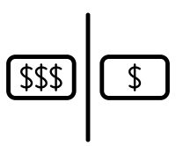

Cheaper Is Not Better:
On the Superior Performance of High-Fee Mutual Funds
V
Jinfei Sheng, Mikkail Simutin, Terry Zhang
Review of Asset Pricing Studies (2023)
Presenter: Ly Nguyen

Slide 2
A long-lasting Fee-Performance Puzzle of Mutual Funds
Economic theories suggest that
Fund fees should be proportional to the value it create for investors
Skilled managers should generate better performance before-fee, then capture all surplus by charging higher fees → flat relation between fund expenses and net-of-fee performances
However, empirical studies document that investors in high-fee funds earn significantly worse factor-adjusted returns net of expenses than in low-fee funds

Slide 3
Relevant papers discussed in this class provide mix evidence
Carhart (1997, JF): Efficient market hypothesis – mutual fund returns are mostly driven by momentum effects rather than to the stock-picking skills of mutual fund managers
Berk & Green (2004, JPE): The failure of fund managers as a group to outperform passive benchmarks does not imply they are lack of skill (as funds attract more capital inflows after periods of strong performance and thus dilute the previously superior returns)
Fama-French (2010, JF): Mutual fund performance is mostly driven by luck rather than skill, and funds do not exhibit persistent outperformance over time
BUSI 525 Problem Set 1: While there is evidence that some fund managers are skilled, it is hard to identify it definitively due to randomness and the limitations of statistical tests in isolating skill from luck

Slide 4
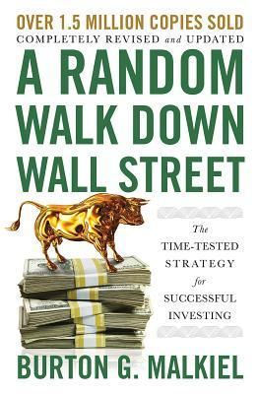
What are practitioners missing?
“I suggest that investors never buy actively managed funds with expense ratios above 50 basis points” (Malkiel, 2016)
Why do high-fee funds still exist if they charge more than the value they add?

Slide 5


This paper
Objective: Resolve the fee-performance puzzle
Main results:
Funds with different expense ratios invest in fundamentally different stocks
Prefer younger firms in rapid expansion stage that have not yet achieved high profitability
Valuing high asset growth and low profitability firms are mispriced by conventional asset pricing models
After adjusting for these factors, high-fee funds significantly outperform low-fee funds pre-expenses
Mechanisms:
Naïve investor hypothesis (managers invest more in fast-growing companies to attract unsophisticated investors)
Valuation cost hypothesis (analyze high-investment low-profit stocks requires more effort → compensate fund managers higher)

Slide 6
Data (1980-2017)
Fees, AUM, monthly returns, …
Stock holdings and transactions
Stock/firm-level characteristics
Analyst forecasts
CRSP Mutual Funds
Thomson Reuters Mutual Funds
Compustat/CRSP/
EDGAR
I/B/E/S
MFLINKS tables
gvkey/permno
Notes:
MFLINKS tables = these two data sets have different structure and frequency + some funds also went through merger or splits → cannot just merge based on fund number and year → MFLINKS table includes additional variables that make the merge accurate

Slide 7
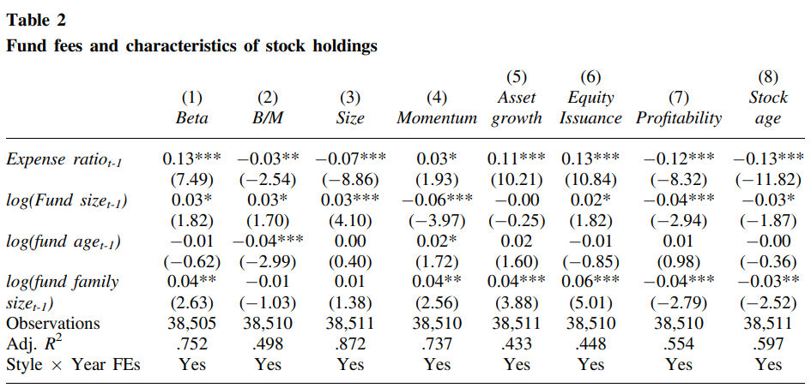
Funds with different expenses invest in systematically different stocks High-fee funds tilt their portfolios towards younger firms in expansion stage that haven’t yet achieved high profit
My Replication

Slide 8
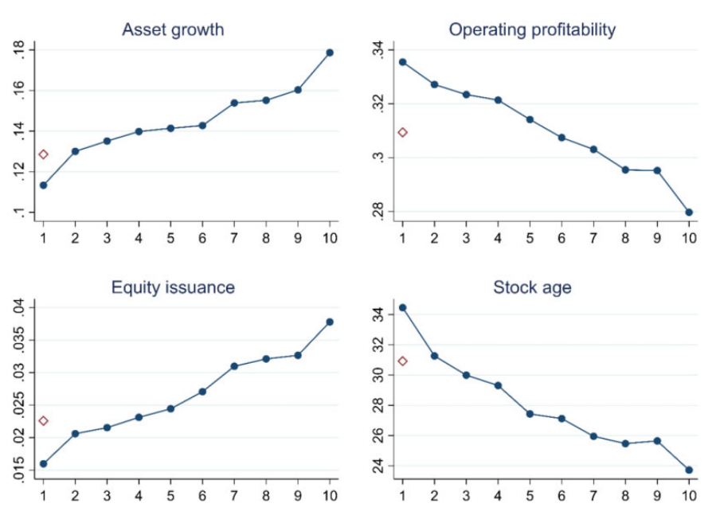
Characteristics of stock portfolios by fund fee deciles
Stock characteristics change monotonically with fees
Stock characteristics of index funds are more similar to those of low-fee funds than high-fee funds

Slide 9
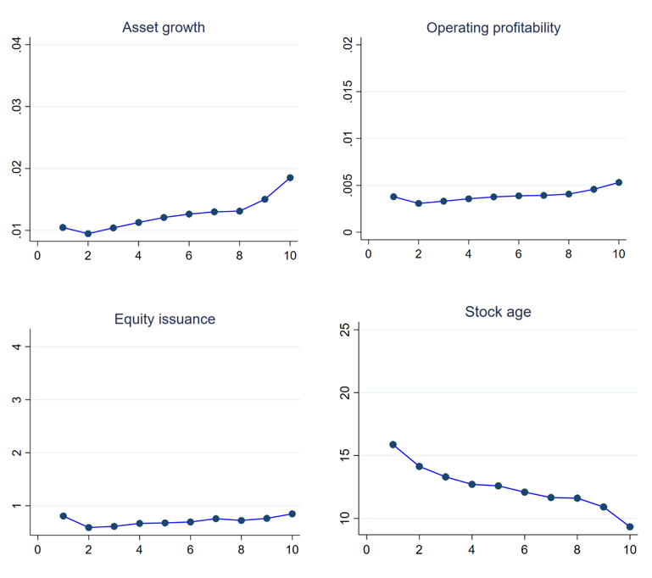
My Replication
Notes:
Got similar increasing pattern for Asset growth and downward trend for Stock age, but flat for Profit and Equity issuance …

Slide 10
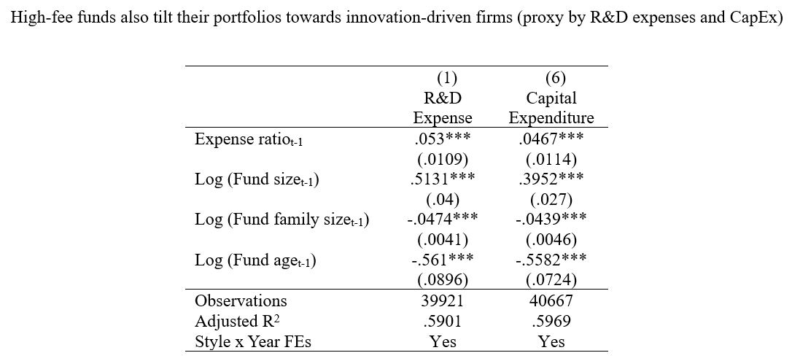
My Replication (Extension)

Slide 11
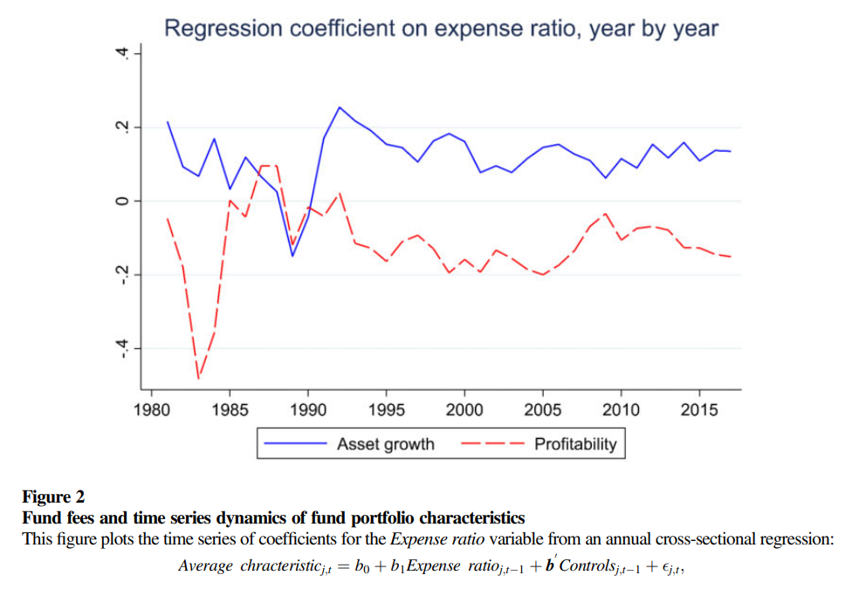
The differences in portfolio characteristics of funds charging different fees have been persistent over time

Slide 12

What are we missing?
Literature has shown that the stock characteristics of fast-growing low-profitability firms are associated with lower expected returns (e.g., Fama and French 2015; Hou, Xue, and Zhang 2015) → Failure to account for these characteristics can lead to erroneous conclusions on the fee-performance of mutual funds
Alpha is computed as:

Slide 13
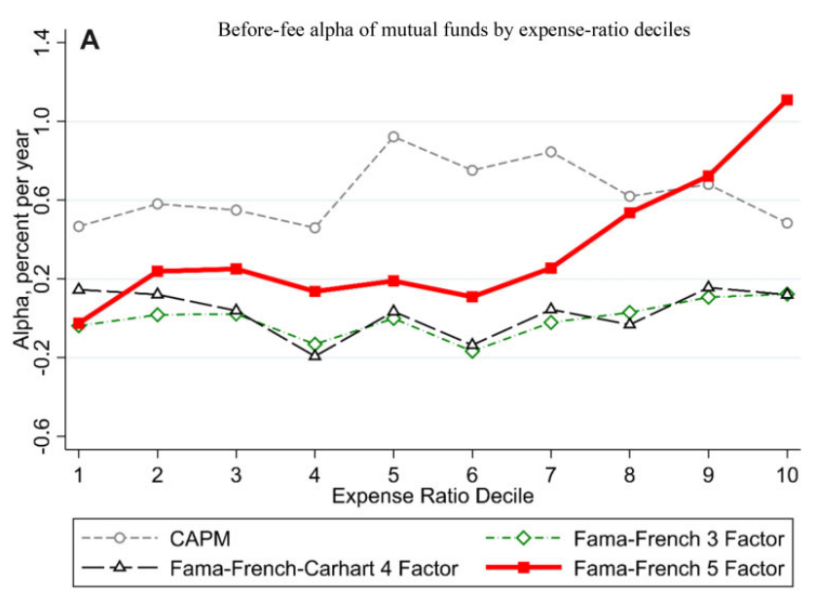
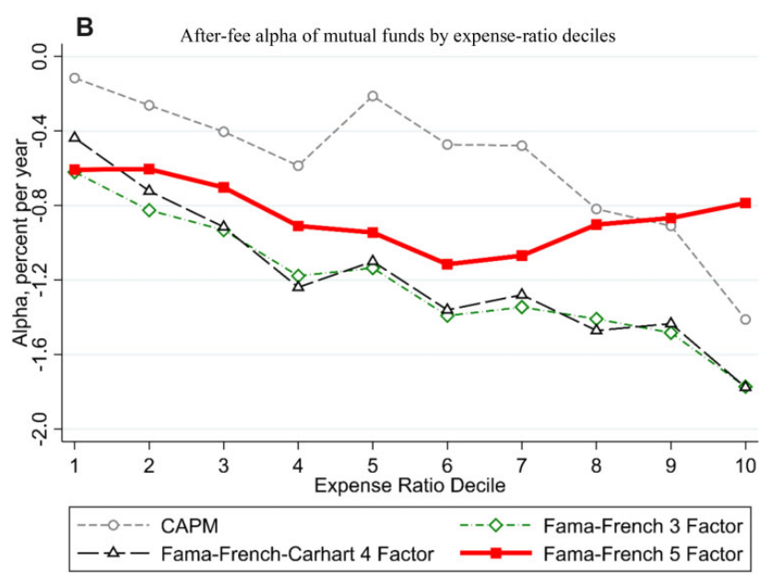
Results under FF5 are consistent with Berk and Green (2004) Skilled managers extract rents by charging higher fees
Under FF5, funds with higher fees deliver substantially better performance
Under FF5, the seemingly poor performance after fees of high-fee funds disappear

Slide 14
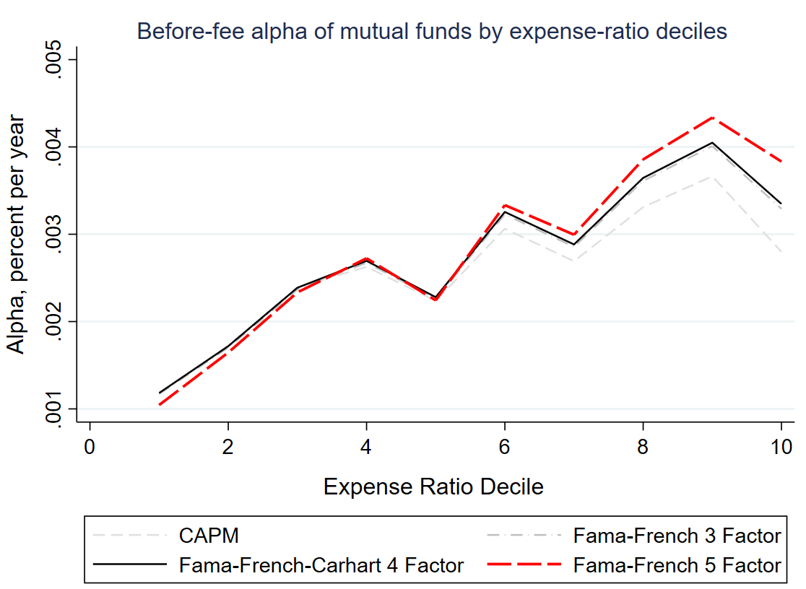
My Replication
My replication shows a close intuition: After controlling for investment and profitability factors under FF5, high-fee funds managers deliver better gross performance

Slide 15
Mechanisms: Naïve investor hypothesis?
Behavioral finance literature: unsophisticated investors over-extrapolate high growth rate of a company into a future and over-invest, causing it to be overpriced (LLSV, 1997; Lakonishok, Shleifer, and Vishny, 1994)
Naïve investor hypothesis: fast-growing companies are more appealing to unsophisticated investors, thus high-fee fund managers tend to invest more in these stocks to attract them
Two measures of a fund’s investor sophistication:
% of fund assets in the institutional share classes
% of fund assets sold through broker channels rather than directly to investors

Slide 16
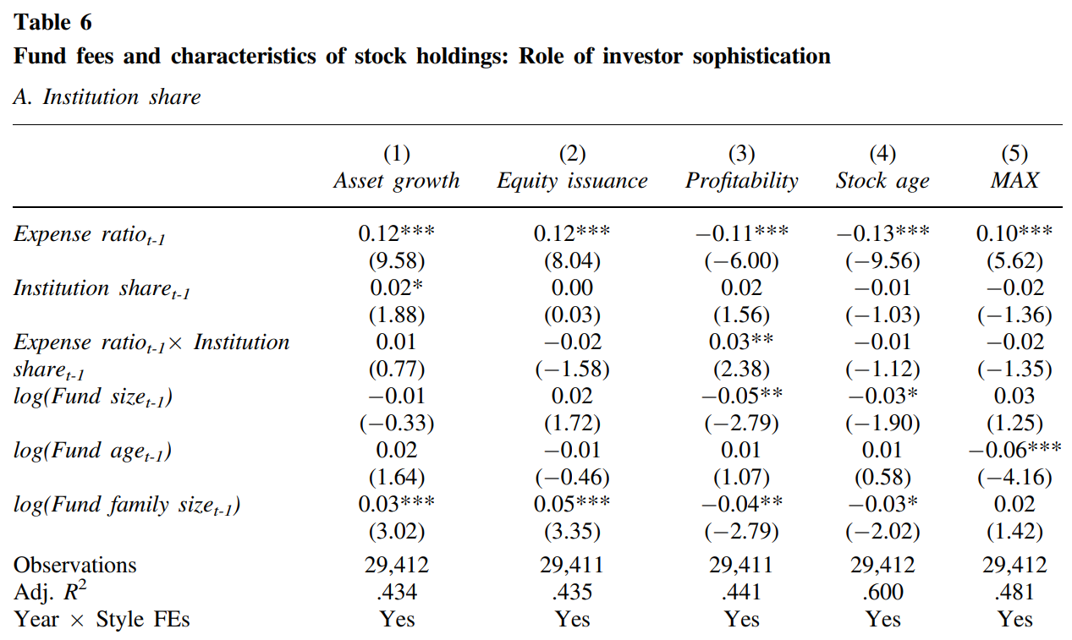
Results do not support the Naïve investor hypothesis

Slide 17
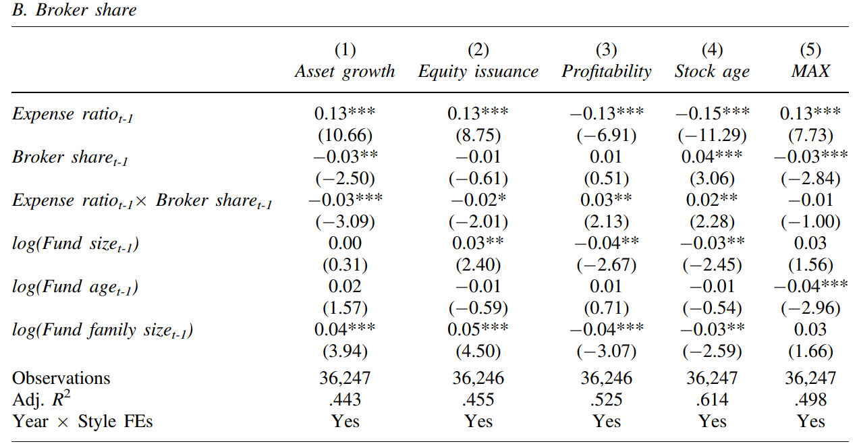
Results do not support the Naïve investor hypothesis

Slide 18
Mechanisms: Valuation cost hypothesis?
Valuation cost hypothesis:
Analyzing the intrinsic value of high-investment low-profit companies is more difficult → compensate fund managers more via higher management fees
These stocks earn lower expected returns, but produce higher alpha
Three measures of whether a company is hard to value:
Idiosyncratic volatility (Ang et al., 2006; Kumar, 2009)
Tangibility (Baker and Wurgler, 2006)
Analyst forecast dispersion (I/B/E/S database)
Expense ratio = Asset management fees + Marketing/Distribution costs (12b1 fees)
Notes:
Analyst forecast dispersion – stocks that professional analyst disagree more on their values are harder to analyze

Slide 19
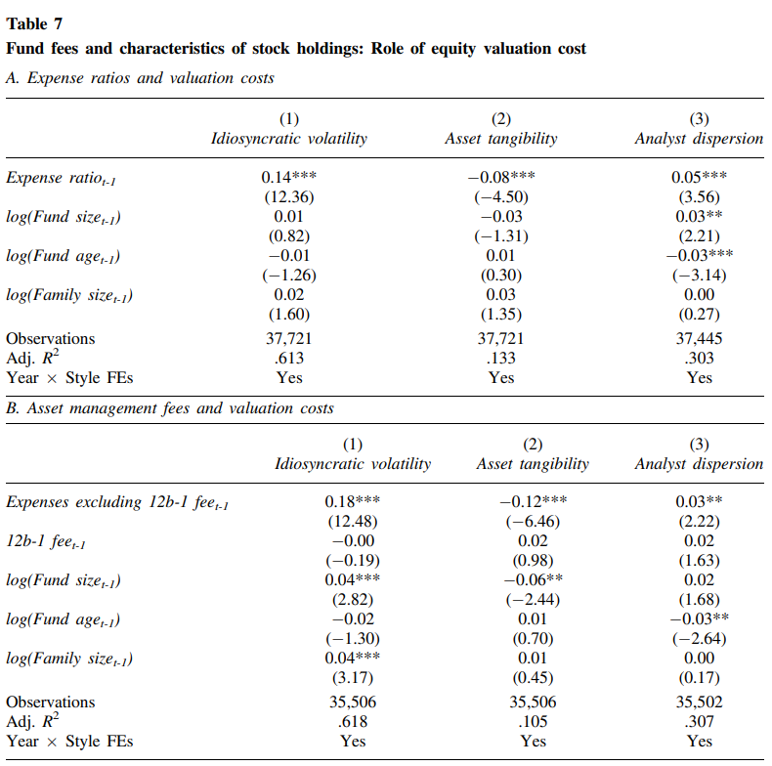
Evidence supports the Valuation cost hypothesis

Slide 20
Evidence supports the Valuation cost hypothesis
Notes:
Coefficients are even higher → The high feed are primarily driven by higher compensation for fund managers for putting on their efforts

Slide 21
Further evidence supports the Valuation cost hypothesis
Data: EDGAR (Form 497K, Principal Investment Strategies [PIS] section of summary prospectus)
Textual analysis on the language that funds use to describe their investment strategies
Construct research index = fraction of words related to research (such as analyze, fundamentally-based, valuation, mispriced, research, …)

Slide 22
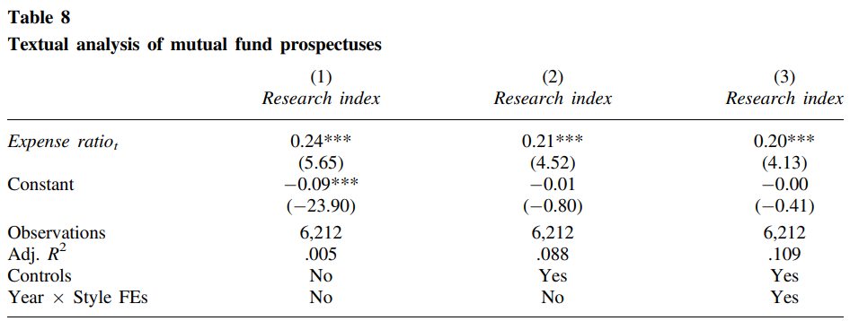
High-fee funds focus more on research and fundamental valuation when describing their investment strategies

Slide 23
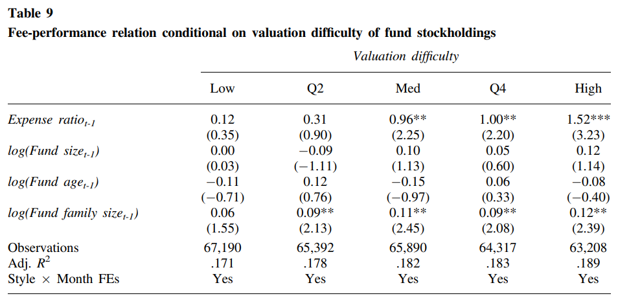
Further evidence supports the Valuation cost hypothesis
High-fee funds that invest in hard-to-value companies and compensate managers richly for greater valuation effort are able to generate better gross performance

Slide 24
Discussion

Slide 25
A great paper with great results and intuition!
(Seemingly) Robust results through clear mechanisms and several additional tests:
OVB? → Add additional fund-level controls and look at other stock characteristics
1980 – 2017 is a long period. Structural break or confounding regulatory changes? → Subsample analysis
Cross-sectional correlation bias? → Fama-MacBeth regression
The fee-performance relation of high-fee funds persist both over time and across funds heterogeneity
*** Clear and concise writing ***
Several important implications for both academics and practitioners:
Address the limitations of previously used factor models in fee-performance evaluation of mutual funds
Challenge the common advice to prefer low-fee funds over high-fee counterparts by showing that
High-fee funds invest in fundamentally different stocks
Investors in high-fee funds are not worse-off: lower expected returns, but not lower alpha

Slide 26
Possible follow-up work What drives the investment choices and fee structures of high-fee mutual funds?
Do fund managers set fees as a strategic response to the competitive environment?
Do high-fee funds select hard-to-value stocks to justify their higher fees, or intrinsic to their core investment philosophy?
Would increased reporting transparency force high-fee funds to adjust their risk and investment strategies to be in line with the higher fees they charge? → PAPER PROPOSAL

Slide 27
Paper Proposal – Would enhanced reporting transparency force high-fee funds to adjust their risk and investment strategies to be in line with the higher fees they charge?
Exogenous shock of variation: staggered adoption of the SEC’s new reporting requirements in 2016
Requires mutual funds to file additional monthly reports with the SEC (via Form N-PORT) on risk metrics, portfolio’s holdings, … → Enhance the transparency of fund strategies and risk profiles
Sep 2019: Large mutual funds (> $1B in AUM); Mar 2020: Small mutual funds (< $1B in AUM)
Data: SEC ADV, CRSP/Thomson Reuters MF, Compustat/CRSP, Audit Analytics
Potential hypotheses:
H1 – High-fee funds would experience greater capital inflows and turnover rate as retail (unsophisticated) investors are more confident and informed about the fund’s risk profiles and strategies
H2 – High-fee funds would continue to tilt their portfolios towards high-growth low-profit stocks due to clearer information and investment objectives
H3 – Enhanced transparency would pressure funds to reduce risk-taking activities (reduction in leverage and derivatives usage) and face higher compliance costs
Notes:
Relevant papers/links:
[SEC’s details about N-PORT 2016] https://www.sec.gov/divisions/investment/guidance/secg-investment-company-reporting-modernization-rules
[use the same shock N-PORT 2016] https://papers.ssrn.com/sol3/papers.cfm?abstract_id=4283140
[second shock - 2004 Security & Exchange Commission (SEC) amendments on closed-end funds' advisory rates] https://www.sciencedirect.com/science/article/pii/S0929119920300031?casa_token=pBsEtj3wLE8AAAAA:SgViEeDHewCayj6i54ABdOaSfgePVjiSJbxFlGBbvVL3WlrBtfW-XH8CxEgWHlZzJKptBbSmnUg

Slide 28
Appendix

Slide 29
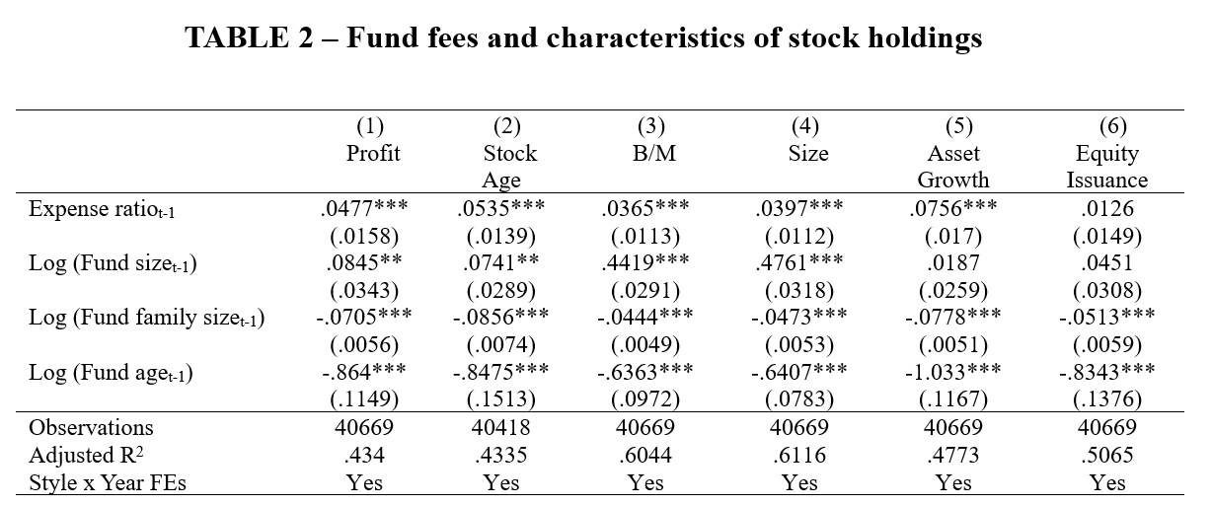
My Replication

Slide 30
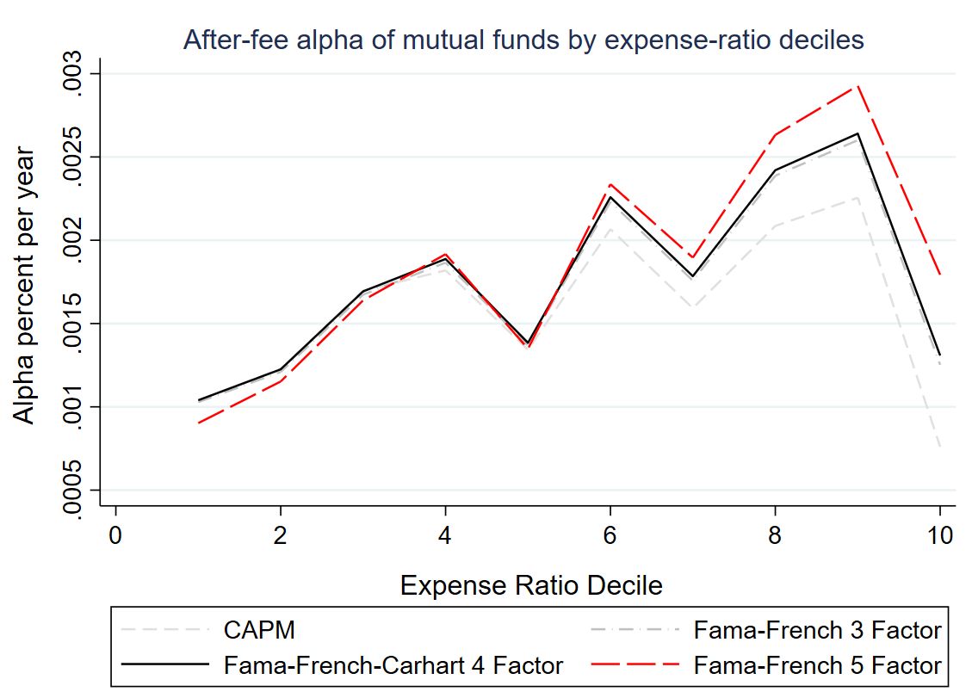
My Replication

Slide 31
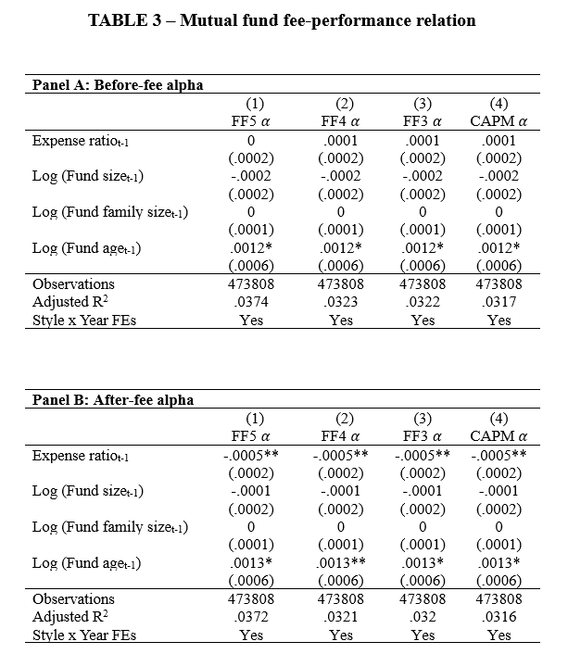
My Replication

Slide 32
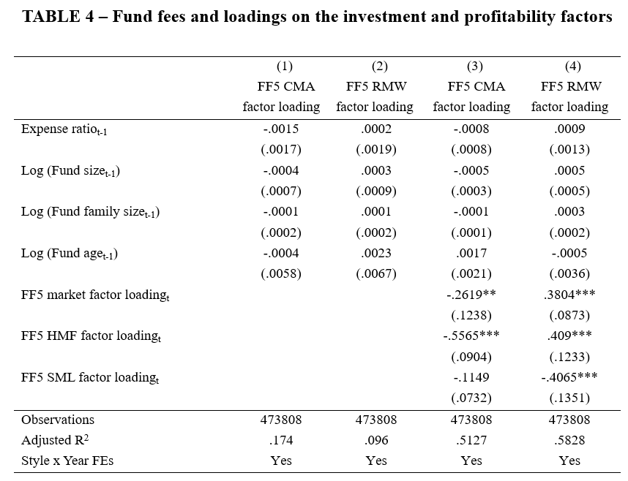
My Replication

